Slide 1
Systems Administration

Slide 2
Users (the bane of the Systems Administrator)
An account (user) is usually identified by a login name (user name).
The system will internally identify each user by a user id (integer).
A password or some other form of authentication is usually associated with an account.

Slide 3
When selecting a username users should remember that in some instances the username is world viewable.
This is particularly common in organisations that have single sign on i.e. centralised account management.

Slide 4
Users
Users will usually also belong to a set of groups. Under UNIX, each user has a primary group and a set of supplementary group memberships.
Files have associated with them an owner (uid) and a group (gid).
Note that the system does not enforce that owners or groups for files actually exist.

Slide 5
Systems have some way to map a user name to a user id. Under UNIX this is the job of the password file.
Actually, the password information may be coming from sources other than a file, such as a NIS+ or a LDAP database.
Other information sources depend on a module called PAM (Pluggable Authentication Module)
We still conceptually talk about the password file.

Slide 6
The Password File
The password file (/etc/passwd) contains an entry for each valid account. The fields are:
Username
Encrypted password placeholder
UID
GID
GECOS information
Home directory
Login shell
jyan:x:1000:1000:Jun Yan,,,:/home/jyan:/bin/bash
Most operating systems support 32 bit user id’s but your mileage varies largely due to file system implementation.

Slide 7
The password file is world readable.
To overcome problems with password cracking, the encrypted password plus additional account information is stored in a shadow password file which is readable only by the super user.
This file is called /etc/shadow.
Anything that reads this file needs to be run as root.
The login program runs Set UID root to allow reading of such a file. In fact anything that reads this file needs to be run as root.

Slide 8
The shadow file
Shadow password files (/etc/shadow) contains the following information;
user name.
encrypted password.
time last changed.
min time between change.
max time between changes.
warn this many days before password expires.
max days of inactivity after expiry before disabled (Solaris)
expire days since Jan 1 1970 that account is disabled. This specified when the account may no longer be used. There is also an additional field which is reserved.
username:passwd:last:may:must:warn:expire:disable:rsvd

Slide 9
UNIX uses a simple one-way encryption algorithm (hash) to encrypt the passwords. Implemented by crypt().
When a plain text password is entered, it is encrypted and the results compared with the value in the shadow password file.
There is no way to find the plain text password from the encrypted password other than by search.

Slide 10
As machines have become faster, it has become possible to perform the encryption step fast enough that people can try a reasonable number of plain text passwords.
This meant that the fact that the plain text passwords were visible became a liability.
Hence the invention of the shadow password file.

Slide 11
The public domain utility “crack” tries to guess passwords given the encrypted versions.
It uses dictionaries and heuristics to guess viable passwords.
Exhaustive search is still not feasible unless you have a lot of hardware.

Slide 12
Some systems use a different hash which is slower to compute than the UNIX crypt function.
This slows down search speed when cracking passwords.
Examples are MD5 or SHA1 cryptographic checksums. (Linux and BSD can do this).
We are beginning to see this technology apply in the file system space as well.

Slide 13
The password comprises of parts:
$1$buJ6v3Ch$BwlfdhdheywydwwD.hdhdjsjw
The first is the cryto system used:
– $1$ means MD5. If there is no leading $ it uses the standard DES.
The password field can be 13 to 24 characters from a 64 character alphabet i.e. a-zA-Z0-9/ and .

Slide 14
In Linux, if the password contains leading !! or is simple :!!: then this means the account is not active
You can restrict account by using /sbin/nologin as the shell but again it varies from platform to platform.
The remaining parameters are set by the passwd () program and depending on the OS can be changed from the default by editing a file like /etc/login.defs

Slide 15
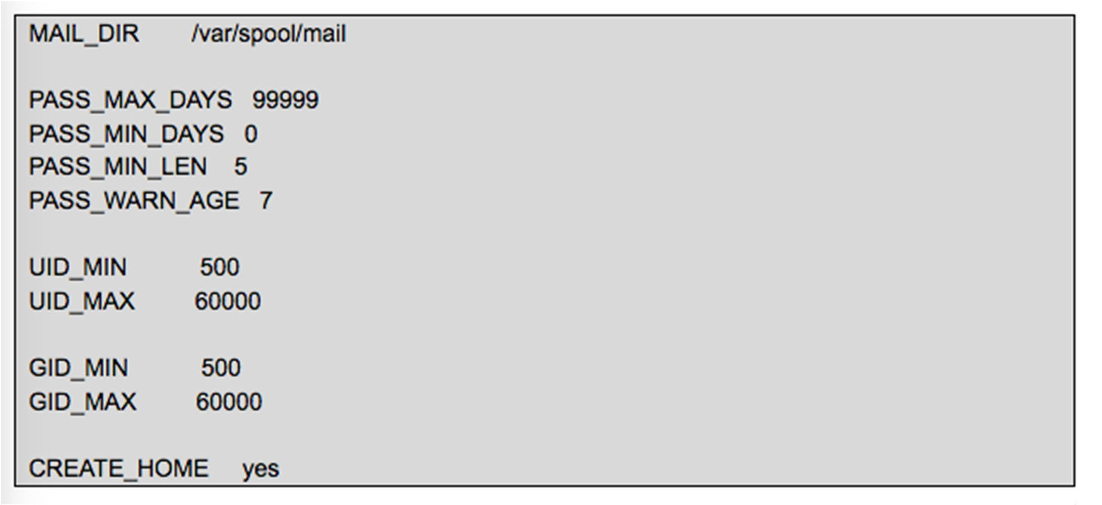


Login.defs
In Linux, to change password policy through command line in Linux, we just have to edit /etc/login.defs file. Only root user can edit this file.

Slide 16
When useradd command is used a user is created. The useradd binary now proceeds with the process of user creation and goes to the /etc/login.defs file to get following values from the file :
MAIL_DIR: Directory where the user's mail will be stored.
PASS_MAX_DAYS: Maximum number of days for the validity of a password.
PASS_MIN_DAYS: Minimum number of days gap before a password can be changed again.
PASS_MIN_LEN: Minimum required length of a password.

Slide 17
PASS_WARN_AGE: Warning for password expiry to be given before the stipulated number of days.
UID_MIN: Minimum value for automatic user id selection.
UID_MAX: Maximum value for automatic user id selection.
GID_MIN: Minimum value for automatic group id selection.
GID_MAX: Maximum value for automatic group id selection.
CREATE_HOME: Whether useradd should create home directories for users .

Slide 18
Directory service
Some systems allow for encrypted passwords and other account information to be accessed via directory services such as:
LDAP
NIS
NIS+
Active Directory

Slide 19
PAM
Pluggable Authentication Modules (PAM) enables a system of shared libraries for authentication
To authenticate a user, an application hands the user to PAM to determine whether the user can successfully identify itself.
Because there are many kinds of authentication scenarios, PAM employs a number of dynamically loadable authentication modules. Each module performs a specific task; for example, the pam_unix.so module can check a user’s password.

Slide 20
LDAP and Kerberos together make for a great combination. Kerberos is used to manage credentials securely (authentication) while LDAP is used for holding authoritative information about the accounts, such as what they're allowed to access (authorization), the user's full name and uid. You can also add in helpful things such as an external email address or a room number in a structured way.
https://wiki.debian.org/LDAP/Kerberos

Slide 21
Password Selection…
Left to themselves users will:
Never change their password.
Choose really stupid ones that are easy to guess.
Cycle their passwords.
Write them down.
Attempt to circumvent you stopping them doing 1,2,3 and 4.
Complain

Slide 22
The administrator must work within the confines of human nature.
If you make passwords too hard to remember, users will write them down.
If you make them change them too often, they will cycle them.
Base your policies on the situation and your security requirements.

Slide 23
User Organization
The next important piece of information in the password file is the group information.
Have some mechanism for grouping your users.
Do this in such a way it is easy to determine which user group any particular account belongs to.
This allows you to easily impose differing quotas/limits etc. on your user groups.

Slide 24
Groups
Groups (as the name implies) are a way of grouping your users together.
Most systems allow file access to be controlled by groups, thereby giving a mechanism for file sharing.
Avoid complicated group structures if possible.
Administration becomes cumbersome and costly in SA time.

Slide 25
Users will also have primary groups (GID).
They will also belong to other secondary groups which are typically enumerated in /etc/group.
name:password:GID:members
Group name may be a maximum of 8 characters
Group password can be a place holder
Each group has a unique identifier
Members field indicates the list of user accounts that are members of the group

Slide 26
The general form of /etc/group is: wheel:x:10:trent,bob,sam
cs-staff:*:100:jyan,risque
From the file you can see group name, group id and membership, what about the x and *.
Groups can have passwords (2nd field) which allow non-members to change to it using the newgrp command.
If the password is an x it means consult /etc/gshadow.
A * in the password field means there is no password.

Slide 27
View and temporarily change your primary group
To display the groups that you are a member of
The groups command
To further display UID, primary GID, and all GIDs for the groups that you belong to
The id command
To change your primary group temporarily
The newgrp command

Slide 28
Home directories
Each user will normally have their own home directory.
Choose a home directory naming scheme which reflects your user grouping structures.
For example at the University we have groups and home areas tied to each group.
This allows you to easily identify which group of users will be affected by file system outages and again allows you to impose differing policies on differing user groups more easily.
User group | Home directory
Staff | /home/staff
Guests | /home/guests

Slide 29
Adding users: the basic steps
Having the new user sign your policy agreement
Edit the etc/passwd and etc/shadow files to define the user’s account
Add the user to the /etc/group file
Set an initial password
Create the user’s home directory
Copy startup files to the user’s home directory
Set up mail alias (it is convenient for each user to receive mail on only one machine)
Update LDAP database (directory services)

Slide 30
Creating user accounts
If you have to add a user by hand, use vipw to edit the passwd and shadow files.
Set the password for the new user with the passwd
command.
You can create the new user’s home directory with a simple mkdir command
You will need to set the ownership and permission by using chown command
You should run the pwck command to check the format of /etc/passwd and ensure that no structural errors have occurred

Slide 31
Startup files
Startup files traditional begin with a dot and end with the letters rc.
Provide default startup files for each shell that is popular on your system, e.g.,
.profile for sh
.bashrc and .bash_profile for bash
Startup files typically set a default environment including
Search path
Terminal type and environemnt
Command aliases
umask value

Slide 32
Startup files are traditionally kept in /etc/skel or /etc
If you customise your vendor’s startup files,
/use/local/etc/skel is a reasonable place to put the modified copies.
/etc may contain system-wide startup files that are processed before the user’s own startup files.
Users can override your settings in their own startup files

Slide 33
Final steps
To verify that a new account has been properly configured, first log out, then login in as th new user and execute the following commands:
pwd (to verify the home directory)
ls –la (to check owner/group of startup files)
Notify new users of their login names and initial passwords
Remind new users to change their passwords immediately

Slide 34
The useradd command
Most systems supply you with an easy to use mechanism for creating accounts.
Ubuntu provides two ways to add users: adduser and
useradd . adduser is a perl wrapper for useradd.
$sudo useradd jyan
$ sudo useradd –c “Jun Yan” –d /home/jyan –g faculty –G famous
–m –s /bin/bash jyan
useradd disables the account by putting an x in the password field, you must assign a real password to make the account usable.
adduser has a twin addgroup and cousins deluser and
delgroup.

Slide 35
Option | Description
-c “description” | Adds a description for the user to the GECOS field
-d homedir | Specifies the user’s home directory
-e expirydate | Specifies the date to disable the account
-f days | Specifies the number of days that an inactive account will be disabled
-g group | Specifies the primary group for the user
-G group1, group2, etc. | Specifies all other group memberships for the user
-i | When used with the –u option, it allows a UID that is being aged to be used

Slide 36
Option | Description
-k directory | Specifies the skeleton directory used when copying files to a new home directory
-m | Specifies that a home directory should be created for the user account
-o | When used with the –u option, it allows a UID to be duplicated on the system
-s shell | Specifies the absolute pathname to the shell used for the user account
-u UID | Specifies the UID of the user account

Slide 37
Adding users in bulk (Linux)
Linux’s newusers creates multiple accounts at one time from the contents of a text file.
The input file should have lines just like the /etc/passwd file, except that the password filed contains the initial password in clear text.
You are probably better off writing your own wrapper for useradd in Perl or Python than in trying to use newusers

Slide 38
Modifying user accounts
The usermod command can be used to safely modify most information regarding user accounts
Option | Description
-c “description” | Specifies a new description for the user to the GECOS field
-d homedir | Specifies the user’s new home directory
-e expirydate | Specifies the date to disable the account
-f days | Specifies the number of days that an inactive account will be disabled
-g group | Specifies a new primary group for the user
-G group1, group2, etc. | Specifies all other group memberships for the user

Slide 39
Option | Description
-l name | Specifies a new login name
-s shell | Specifies the absolute pathname to the new shell used for the user account
-u UID | Specifies a new UID of the user account

Slide 40
Disabling logins
Put a star or some other character in front of the user's encrypted password in /etc/shadow
On Linux, usermod –L user to lock password, usermod
–U user to unlock passwords
Does not notify the user of the account suspension
Replace the user’s shell with a program that prints an explanatory message and supplies instructions for rectifying the situation.
Check if a user’s login shell is listed in /etc/shells

Slide 41
Removing users
If you remove a user by hand
Remove the user from any local user databased or phone lists
Remove the user from the aliases file or add a forward address
Remove the user crontab file and any pending at jobs or print jobs
Kill any of the user’s processes that are still running
Remove the user from the passwd, shadow, group, and gshadow files
Remove the user’s home directory
Remove the user’s mail spool

Slide 42
The userdel command
The userdel command removes entries from both
/etc/passwd and /etc/shadow corresponding to the user account
-r option removes the home directory
Any files that were previously owned by the user become owned by the number that represents the UID of the deleted user
Any future user account that is given the same UID then becomes the owner of those files

Slide 43
Managing groups
Edit /etc/group file using a text editor
You should run grpck command to check the format of
/etc/group and ensure that no structural errors have occurred
There are commands similar to user management, e.g.,
groupadd, groupmod, and groupdel

Slide 44
Managing accounts
Again depending on the OS there are lots of little tools to manage users and groups - some examples include:
adduser/ useradd
userdel
groupadd, groupmod, groupdel
chage (changes /etc/shadow info)

Slide 45
Traditional UNIX access control
Objects have owners. Owners have broad control over their objects.
You own new objects that you create.
The special account called “root” can act as the owner of any object.
Only root can perform certain sensitive administrative operations.

Slide 46
Filesystem access control
Every file has both an owner and a group (aka group owner)
The owner can set the permissions of the file for
The owner
The group
Everyone else
The permission is defined as read, write, and execute
Both the kernel and the filesystem track owners and groups as numbers rather than as text names

Slide 47
The root account
The root account is the superuser account
The root account has a UID of 0
Example of root operations
Changing the root directory of a process with chroot
Creating device files
Setting the system clock
Raising resource usage limits and process priorities
Setting the system’s hostname
Configuring network interfaces
Opening privileged network ports (below 1,024)
Shutting down the system

Slide 48
Role based access control
A layer of indirection is added to access control calculations.
Roles are similar to groups but can be used outside of the context of the filesystem.
Roles can have a hierarchical relationship to one another.
Solaris can manipulate roles using roleadd, rolemod, and roledel
Is the role the same as group?

Slide 49
The root account
You need to keep the root account password safe.
Change the root password regularly.
Avoid using the root password over networks.
Keep it secure (written down in and in a safe).
Avoid it like the plague.

Slide 50
su: substitute user identity
If invoked without arguments, su prompts for the root password and then starts up a root shell.
Root privilege remain in effect until you terminate the shell.
The su command can also substitute other identities other than root: su –username
Type the full pathname suchas /bin/su rather than su
su has been largely superseded by sudo

Slide 51
sudo: limited su
sudo is a package that allows you to delegate root powers or a subset to conventional users.
Users authenticate to the sudo program and then can do what they wish providing it fits in certain parameters.
sudo runs setuid root but consults a file called
/etc/sudoers.
sudo prompts user’s own password
Additional sudo commands can be executed until 5 minutes have elapsed with no further sudo activity.
sudo keeps a log of sudo activities.

Slide 52
The file has directives such as this:
The users to whom the line applies
The hosts on which the line should be heeded
The commands that the specified users can run
The users as whom the commands can be executed
ALL ALL=/dialup,/hangup
This directive allows all users to execute the commands dialup
and hangup.
jim ALL=/dialup,/hangup
In this case the user Jim can run the commands.
%admin ALL=(ALL) ALL
Members of the admin group may gain root privileges

Slide 53
If you would like the user jyan to do things as root you could go;
jyan ALL=(root) ALL
You can do many things with sudo e.g. define groups and other properties.
To modify /etc/sudoers, you use the visudo command

Slide 54
Advantages of using sudo
Accountability is improved
Operators can do chores without unlimited root privileges
The real root password can be known to only few people
It’s faster to use sudo
Privileges can be revoked without changing the root password
There is less chance of a root shell being left unattended

Slide 55
The Filesystem
The basic purpose of the file system is to represent and organise the systems storage resources.
File systems on various partitions (logical or physical) are combined to form the real file system.
The top level directory is often called root ‘/’.
The file system structure result in it becoming an inverted tree structure.

Slide 56
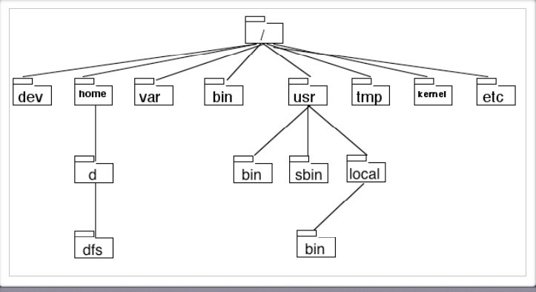
A typical filesystem structure

Slide 57
Objects in the file system can be identified by using their absolute or relative pathing.
Absolute pathing is the entire path through the file system to get to the actual object.
Relative pathing is the path ‘relative’ to the current working directory.

Slide 58
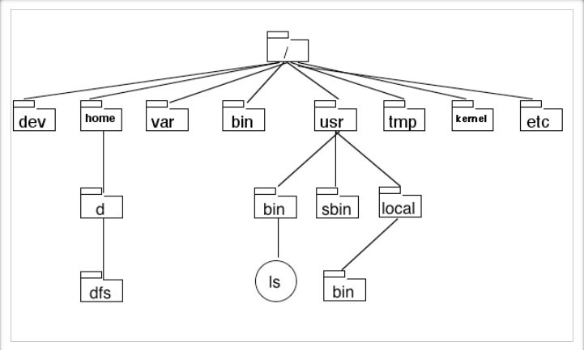
In this example the absolute path of ls is /usr/bin/ls.

Slide 59
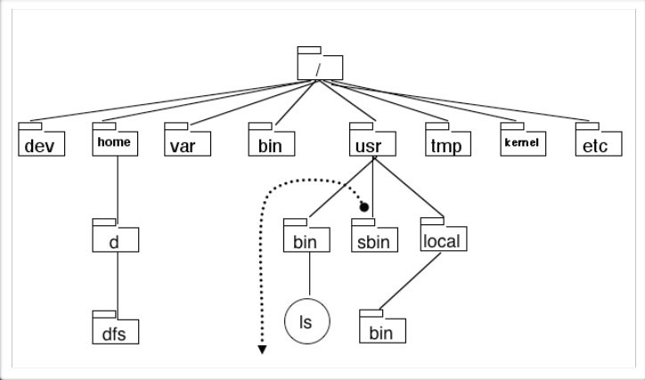
The relative path of ls is ../bin/ls. The path is relative to the current working directory.

Slide 60
The Filesystem Hierarchy Standard (FHS)
www.pathname.com/fhs/
Directory | Description
/bin | Binary commands for use by all users
/dev | Device files
/etc | System-specific configuration files
/home | Default location for user home directories
/lib | Shared program libraries
/mnt | Empty directory used for accessing disks such as floppy disks and CD-ROMs
/opt | Additional software programs

Slide 61
Directory | Description
/proc | Process and kernel information
/root | Root user’s home directory
/sbin | System binary commands (used for administration)
/tmp | Temporary files created by programs
/usr | System commands and utilities (/usr/bin, /usr/games/, /usr/include/, /usr/lib, /usr/local, /usr/sbin/, /usr/share/, /usr/src/, /usr/X11R6
/var | Log files and spools

Slide 62
Filesystem type
Many filesystems are available for use in UNIX
You need not use only one type of filesystem on the system
Files and directories appear the same throughout the directory tree regardless of whether the UNIX system uses 1 filesystem or 20 different filesystems.
Some common UNIX filesystems are:

Slide 63
Filesystem | Description
BFS | Boot Filesystem – a small filesystem used to hold files necessary for system startup
CDFS | Compact Disk Filesystem – used to view all tracks and data on a CD-ROM as normal files
DOSFS | DOS FAT Filesystem – used to access Windows floppy disk
HFS | High Performance Filesystem – used in HP-UX systems, based on S5
NFS | Network Filesystem – used to access filesystems on UNIX computers across a network
NUCFS | Netware-UNIX Client Filesystem – used to access Novell Netware filesytems from across a network

Slide 64
Filesystem | Description
S5 | System V Filesystem – supported on all UNIX flavors
SFS | The Secure Filesystem – a variant of UFS that allows for secure access to files on the filesystem
UFS | The UNIX Filesystem – an improved version of the S5 filesystem and the default for Solaris
VxFS | The Veritas Filesystem – a journaling filesystem that offers large file support and extend-based allocation, and supports ACLs. It is also known as the Journaling Filesystem (JFS) and is the default filesystem on UnixWare and HP-UX systems

Slide 65
Check the filesystem type
df Command – Find Filesystem Type.
fsck – Print Linux Filesystem Type.
lsblk – Shows Linux Filesystem Type.
mount – Show Filesystem Type in Linux.
blkid – Find Filesystem Type.
file – Identifies Filesystem Type.
fstab – Shows Linux Filesystem Type.

Slide 66
Mounting and unmounting
A filesystem can be
A disk partition
A disk-based logical volume
A network file server
A kernel component
A memory-based disk emulator
Etc.

Slide 67
Filesytem mounting and unmounting
File systems are attached to the tree with the mount command. mount maps a directory within the existing file tree, called the mount point, to the root of the newly attached filesystem. For example,
mount /dev/sda4 /users
installs the filesystem store on the disk partition
/dev/sda4 under the path /users

Slide 68
To unmount the file system we use the unmount
command.
The kernel keeps track of what process file descriptors as associated with
As a consequence you cannot unmount a file system that has a object opened by a process.
Except of course if you use the -f (force unmount option).

Slide 69
You can find out who is using what file systems by using either;
lsof is a open source program which peeks into kernel structures for all processes. It can report what files any process has open, file descriptors and even network sockets.
fuser returns the PID’s of processes that happen to have open file descriptors. It initially appeared in FreeBSD but now is mainstream.

Slide 70
File types
Regular files (-)
Directories (d)
Character device files (c)
Block device files (b)
Local domain sockets (s)
Named pipes (FIFOs) (p)
Symbolic links (l)
You can determine the file type with ls –l. The first character of the output encodes the type.

Slide 71
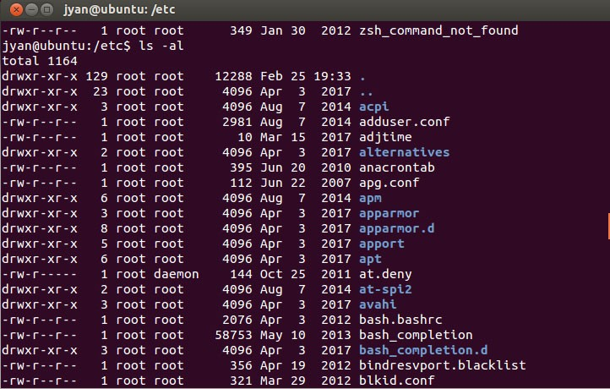

Slide 72
Programs communicate with the system’s hardware using device files.
Character device files allow their associate drivers to do their own input and output buffering
Block device files are used by drivers that handle I/O in large chunks and want the kernel to perform buffering for them.
Most systems today implement some form of automatic device file management. On Linux distributions, /dev is a standard directory for device files.

Slide 73
Sockets are connections between processes that allow processes to communicate hygienically.
Local domain sockets are accessible only from the local host and are referred to through a filesystem object.
Created with the socket system call and removed with the rm command.
Named pipes also allow communication between two processes running on the same host.
Created with mknod and removed with rm.

Slide 74
A symbolic link points to a file by name.
It redirects its attention to the pathname stored as the contents of the link.
A hard link is a direct reference while a symbolic link is a reference by name.
Links can be created with the ln command

Slide 75
Filesystem structure
A filesystem has
The superblock which defines the information about the filesystem in general
The inode table which consists of several inodes, each describing one file or directory and containing a unique inode number for identification. The inode also stores information such as the file size, data block locations, last date modified, permission and ownership.
The data that makes up the contents of the file as well as the filename are stored in data blocks that are referenced by the inode.

Slide 76
Hard linked files are direct copies of one another as they share the same inode and inode number.
If one file is modified, all hard linked files will be updated as well.
Deleting a hard linked file does not delete all the other hard linked files.
The command ln file1 file2 will make a hard link to file1 called file2.

Slide 77
Symbolic links do not share the same inode and inode number with their target file.
The data block in a symbolically linked file contain only the pathname to the target file.
When you edit a symbolically linked file, you are actually editing the target file.
If the target file is deleted, then the symbolically linked file servers no function
The command ln -s file1 file2 will make a symbolic link to file1 called file2.

Slide 78
List the inode number of the file
To display the inode number of a file, you can run
ls –i /etc/passwd
stat /etc/passwd

Slide 79
File ownership
When a user creates a file, that user’s name and primary group becomes the owner and group owner of the file.
The owner and the root can change the ownership of the file (and the permissions on the file)
chown user1 file1
chgrp group1 file1
Normally you should change both
chown user1:group1 file1

Slide 80
File permissions
Permissions on a file is stored in the inode of the file
It is called the mode and divided into three sections
User (owner) permissions
Group permissions
Other permissions
The regular permissions are
Read
Write
Execute

Slide 81
Interpreting the mode
r w x r w x r w x
user
group
other
mode

Slide 82
Changing permissions
Use chmod criteria filename to change the permissions
chmod u+w,g+r-w,o+r-x file1
chmod u=rw,g=r,o=r file2
chmod a+x file3
chmod +x file4
Ensure no space between any criteria
Criteria can be numeric
read = 4
write = 2
execute = 1
– rwx = 4+2+1 =7

Slide 83
Directory permissions
The read bit allows the affected user to list the files within the directory
The write bit allows the affected user to create, rename, or delete files within the directory, and modify the directory's attributes
The execute bit allows the affected user to enter the directory, and access files and directories inside
The sticky bit states that files and directories within that directory may only be deleted or renamed by their owner (or root) (see slide 88)

Slide 84
chmod 540 file1
chmod 644 file2
chmod 777 file3

Slide 85
Default permissions
By default, new files are given rw-rw-rw-
By default, new directory are given rwxrwxrwx
A special variable umask takes away permission on new files and directories immediately after they are created
The most common umask value is 022. what does it mean?
When you log in and obtained a new shell, the default umask is loaded
When you exit, your umask is destroyed

Slide 86
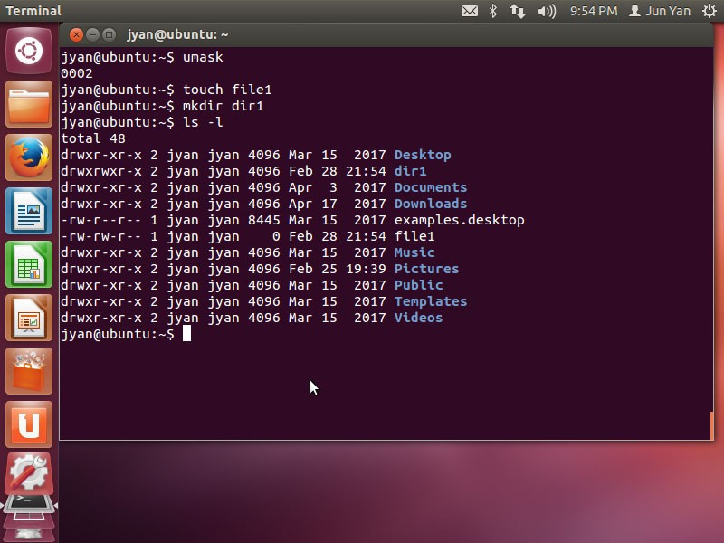

Slide 87
Changing the ACL
In addition to user, group, and other, you may change the Access Control List by using the setacl command (setfacl in Linux)
setfacl –m u:lisa:r file
setfacl –x g:staff file
getfacl file1 | setfacl --set-file=- file2

Slide 88
Special permissions
Set user ID (SUID)
If set on a file that is executable, the person who executed the file temporarily becomes the owner of the file while it is executing.
Set group ID (SGID)
If set on a file that is executable, the person who executed the file temporarily becomes a member of the group that is attached to the file during execution.
Sticky bit
If set on a directory in addition to the write permissions, the users may add files to the directory but only delete those files that they have added and not others.

Slide 89
Setting special permissions
Sticky bit
SGID SUID
r w x r w x r w x
special
user
group
other
chmod 6755 file1
chmod 1777 dir1
chmod 1770 dir1
Mask the execution permissions from rwxrwxrwx to
rwsrwsrwt
rwSrwSrwT

